Slide 1
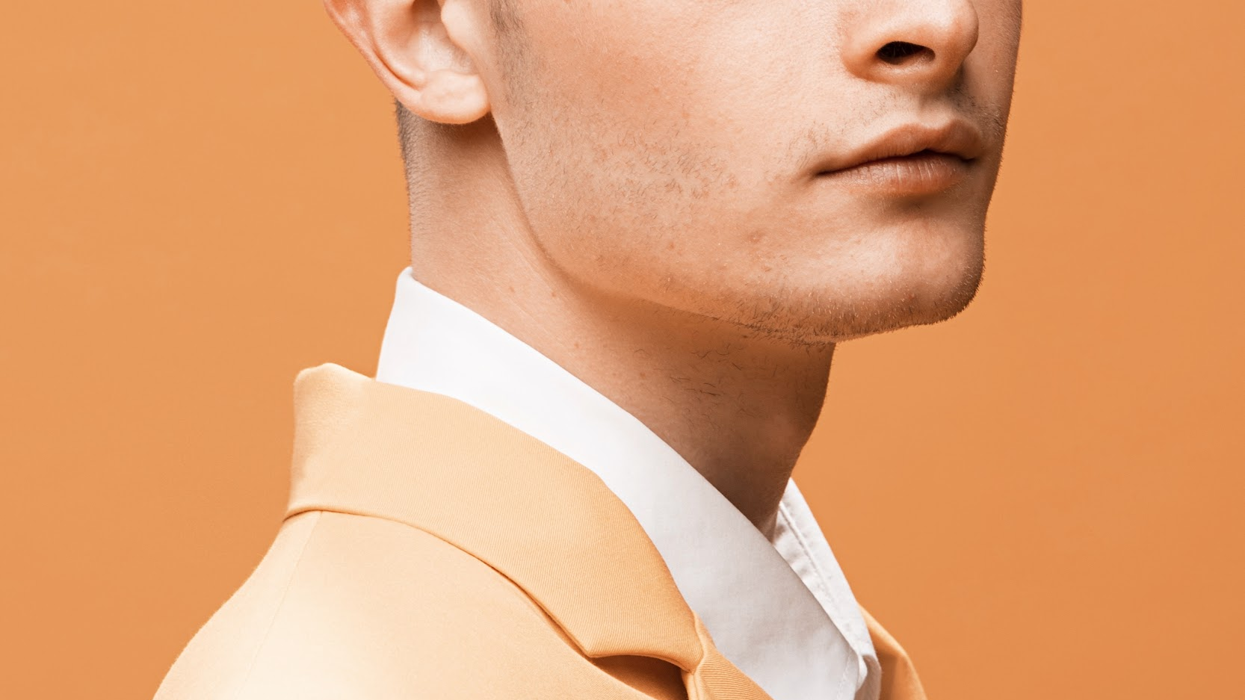
Tom
Patterson
PORTFOLIO || TOM PATTERSON
By: Yee Ping, Kabilash, Stefanie, Sze Yan and Dylan

Slide 2
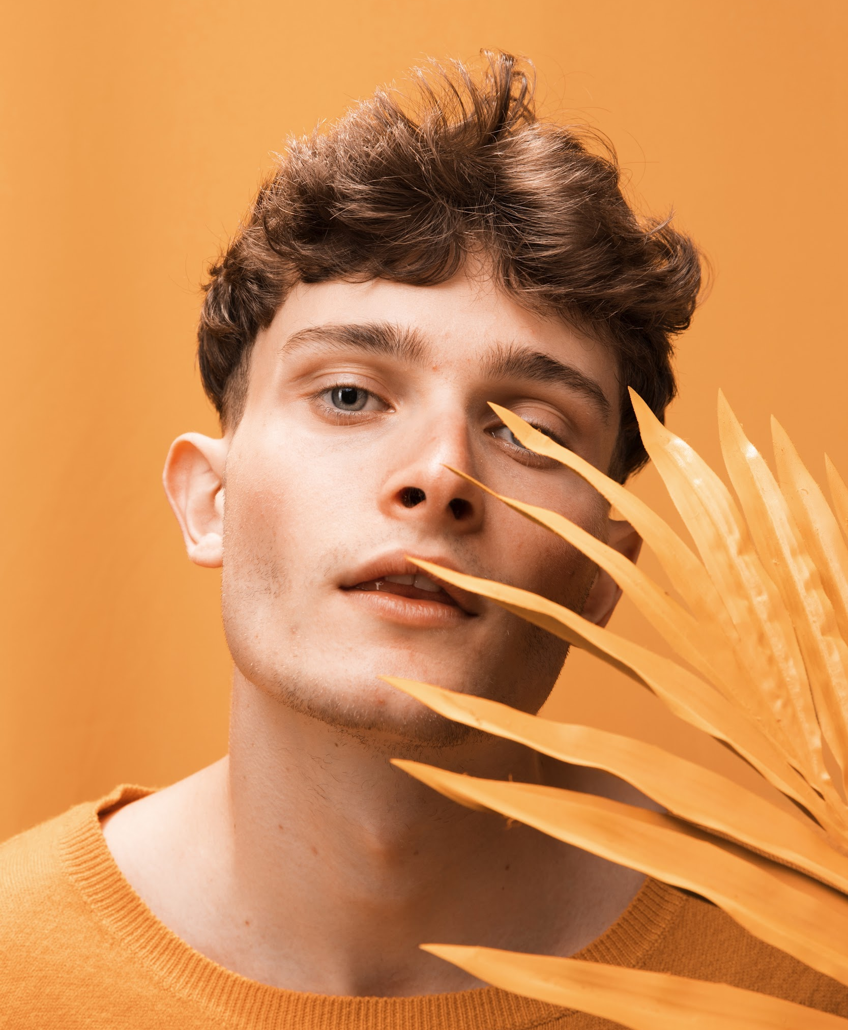
About Us
Group of passionate individuals wanting to revolutionise the fashion industry by making sustainable fashion the new future
Notes:
Tom Patterson was born in 2021 on a half-year semester road trip from SengKang to Ang Mo Kio. Founders Sze Yan and Stefanie spent as much time in nature as possible and met the rest of us founders, Yee Ping, Kabilash and Dylan, along the journey.
Immersing ourselves in nature reminded us of the impact we have on the environment and our responsibility to minimise our carbon footprint.
We realised business was the most impactful way to revolutionise the future of fashion. And so every time you support Tom Patterson, you are funding GRCs to plant 3 trees, offsetting your impact, and nourishing ecosystems.

Slide 3
Needs
Need to reach out to more customers
Need to increase our market share in this industry to become the dominant platform
Need to increase sustainable business tactics within the fashion industry

Slide 4
Yee Ping
Sze Yan
Proposed Application
Kabilash
Stefanie
Dylan
Game + Leaderboard
Order + Order History
Supplier
Forget Password
Homepage
Admin Dashboard
Shopping Cart
Auction
About Us
Contact Us
User Profile
Shop
Product page
Marketplace
Auction
Login
Sign up
Product Admin Page
User Admin Page

